Slide 1
Opening a New Filipino Restaurant

Slide 2
Location is Key
Want to be near a large Filipino population
Restaurants with good ratings indicate a good neighborhood, but also pose competition

Slide 3
Data Acquisition/Cleaning
New York City neighborhood information found here
https://cocl.us/new_york_dataset
Restaurant data obtained from Foursquare API

Slide 4
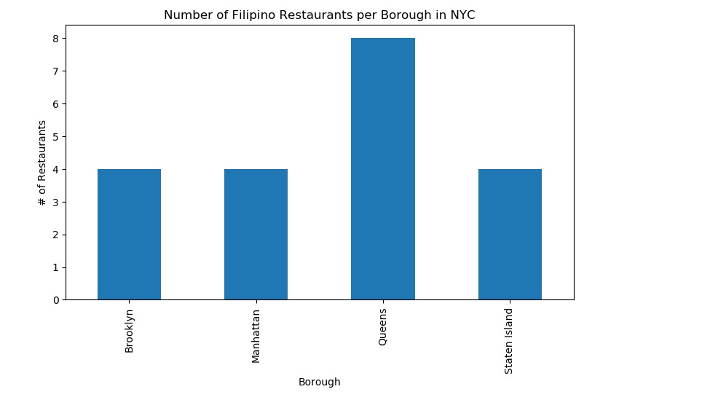
Queens is the King of Boroughs
Queens contains the most restaurants out of all the boroughs
Only 20 restaurants in the city, 8 are located in the Queens borough

Slide 5
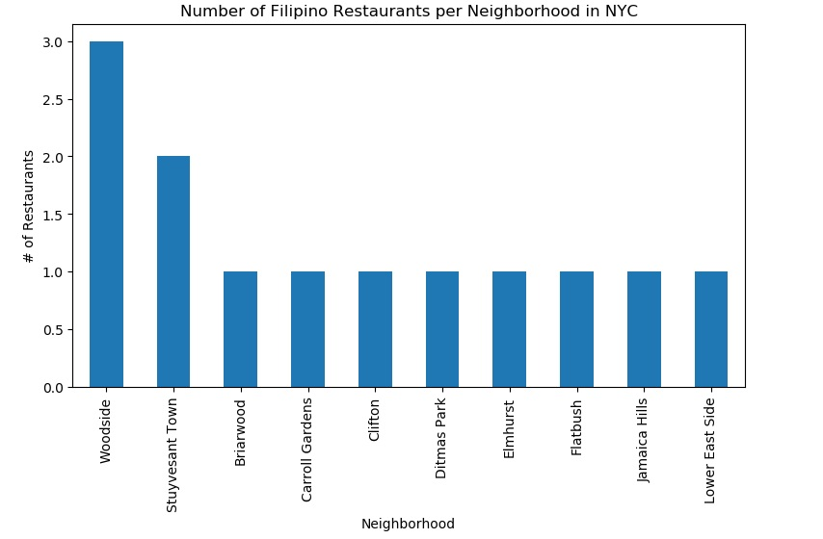
Woodside vs. Everyone else
Woodside contains the most restaurants per neighborhood
Other neighborhoods contain only 1 restaurant

Slide 6
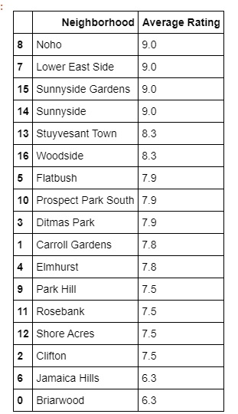
Neighborhood Rating
Woodside does not have the best rating out of the neighborhoods
Noho, Lower East Side, and Sunnyside have high ratings but only 1 restaurant each

Slide 7
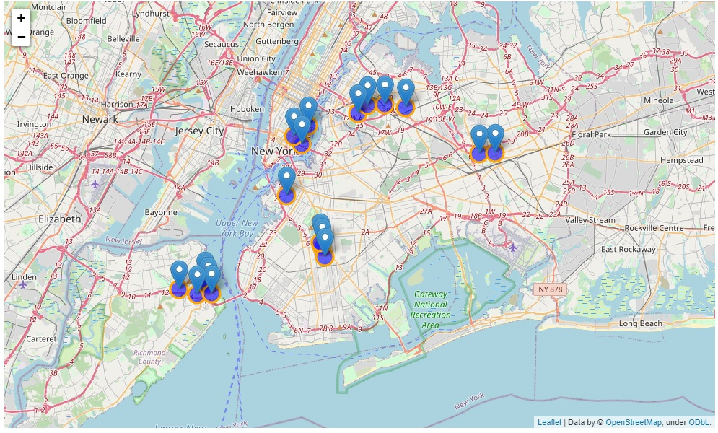
Where the restaurants are
Overall, restaurants are clustered very close to each other, in tight neighborhoods.
Many are in Queens but there are other restaurant dense locations

Slide 8
Conclusion
Queens has a lot of restaurants that are all rated high (>8.0)
More restaurants means more competition
Lone restaurants in less dense neighborhoods are rated very high (>9.0)
Less restaurants means more people can come to you, but higher rated competition might also draw away

